Slide 1
ETL
Extract Transform Load

Slide 2
Extract / Transform / Load
What is it?
Where is it?
Is it important?
How do we do it?

Slide 3
A Quick Note
We are not covering ELT here.
(Extract / Load / Transform)
Mostly used in big data analytics

Slide 4
What is ETL?
Extract, transform and load is, as the name suggests, made up of 3 logical processes.
Extract the data
Extraction is the first step.
Data is collected from your data sources
Transform the data
The data collected by the extract process is cleansed, things like checking for missing data and mismatched formats
Load the data
This is the physical structuring of the transformed data and loading into the target. This could be the BI system itself or a data warehouse.

Slide 5
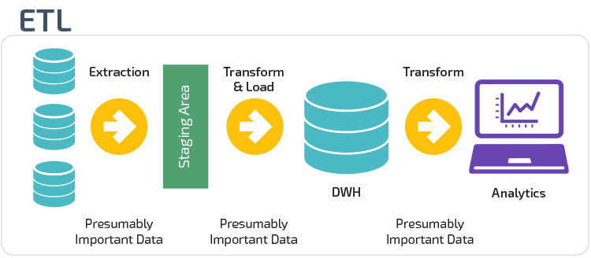
Where is it?
ETL sits between the operational systems and the data warehouse and BI systems.
https://panoply.io/data-warehouse-guide/3-ways-to-build-an-etl-process/

Slide 6
Is it important?
Yes
Without a proper ETL process can you rely on you data?
Do all of your data sources provide you with data in exactly the same format?
Are there missing values?

Slide 7
Data In / Data Out
What does the data look like before it enters the ETL process?
“That depends…”
A database will be delivering data in, hopefully, properly normalised data. (https://www.studytonight.com/dbms/database-normalization.php)
Flat files can be data sources, such as CSV or JSON
So the question is what will the data look like?
We can’t always be sure. It could be in 3 or 4 different formats
It could have some data missing.

Slide 8
How do we do it?
There’s the problem.
The answer is often “That depends…”
On what?
Sources
Limitations on the data
Availability of tools & skills
But this can be risky.
There is no way to be 100% sure that all your data is ready to load into your BI system or data warehouse.

Slide 9
ETL Requirements
Business Need
What does the BI team need?
What does the business itself need?
Compliance
The controls needed for the storage of your data are the same ones needed at each stage of the ETL process
Security
As in the compliance stage, security is just as important all through the ETL process
Data Quality
You need to be able to trust the sources of your data. You must know where any issues such as missing data are likely to be found.

Slide 10
ETL Requirements
Data Integration
This is the whole point of the ETL process. Pulling together data from different sources and making it available in a logical, single place.
Data Latency
How quickly can you deliver the data to the end users?
How often do you need to run the extract to be able to keep your end users happy?
BI Interface
What does the output from the ETL system need to look like? Is it is going to be stored in a data warehouse? Is it going to delivered directly to BI tools?
Skills
Are the relevant skills available?

Slide 11
Extract
This first stage involves:
Data collection from the various sources
Sources can include:
Databases
Web server logs
Customer Relationship Management systems
Etc
Formats can include
CSV
JSON
XML
Output from SQL queries

Slide 12
Transform
Now we need to take the extracted data and run transforms on it
These include
Checking and fixing different measurement units.
If we are taking data from different countries are measurements in the same format? (Inches vs centimetres for example)
Bringing different formats to a common format.
Phone numbers in international format, remove dashes or spaces
Do names have suffixes in some cases such as jnr or snr?
It is the role of the transform stage to ensure data matches the output to a format that is correct for the next stage.

Slide 13
Load
The final stage in this process is to load the data into your target system.
This may be the BI system or it could be a data warehouse.

Slide 14
An Example
Harry Smith, 01736-876501
Joe Smith, 0161-334-8765
John Smith, 0206-345-9876
Mr. Kieran Hissop (0121)-768-0928
Miss Mandy Hurst (07654)-972653
Dr. Alex Inksplot (0114)-2787656
ETL Process
Kieran | Hissop | 01217680928
Mandy | Hurst | 07654972653
Alex | Inkspot | 01142787656
Harry | Smith | 01736876501
Joe | Smith | 01613348765
John | Smith | 02063459876

Slide 15
ETL Tools
Paid For
Oracle Data Integrator
IBM Infosphere DataStage
Microsoft SQL Server Integrated Services
Open Source
Apache Kafka
Talend Open Studio
Apache NiFi

